Slide 1
Introduction to Markov Chains in F#

Slide 2
A Markov chain is a stochastic model describing a sequence of possible events in which the probability of each event depends only on the state attained in the previous event.
source: https://en.wikipedia.org/wiki/Markov_chain

Slide 3
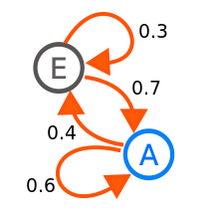
source: https://en.wikipedia.org/wiki/Markov_chain

Slide 4
Applications
Google Page Rank
Physics – thermodynamics and quantum mechanics
Queuing theory
Marketing – customer churn

Slide 5
Weather forecast Will it be Sunny or Rainy day

Slide 6
Forecasting weather
Observation:
RRRRSSSSRRRRRRRRRRRRRRRRRRRSSSSSRR
Random simulation (50/50):
RSRSSRRRSRRSSSSRSRSSSRRSSSRSRRSSRS
Markov chain (90/10):
RRRSSSSSSRRRRRSSSSRRRRRRRRSSSSRRRR
source :http://setosa.io/ev/markov-chains/

Slide 7
Step 1
"RRRRSSSSRRRRRRRRRRRRRRRRRRRSSSSSRR"
|> Seq.windowed 2
val it : seq<char []> =
seq [[|'R'; 'R'|]; [|'R'; 'R'|];
[|'R'; 'R'|]; [|'R'; 'S'|];
[|'S'; 'S'|]; [|'S'; 'S'|]; ...]

Slide 8
Step 2
"RRRRSSSSRRRRRRRRRRRRRRRRRRRSSSSSRR"
|> Seq.windowed 2
|> Seq.groupBy(fun a -> a.[0])
val it : seq<char * seq<char []>> =
seq
[('R', seq [[|'R'; 'R'|]; [|'R'; 'R'|];
[|'R'; 'R'|]; [|'R'; 'S'|]; ...]);
('S', seq [[|'S'; 'S'|]; [|'S'; 'S'|];
[|'S'; 'S'|]; [|'S'; 'R'|]; ...])]

Slide 9
Step 3
"RRRRSSSSRRRRRRRRRRRRRRRRRRRSSSSSRR"
|> Seq.windowed 2
|> Seq.groupBy(fun a -> a.[0])
|> Seq.map(fun (k, e) -> (k,
e |> Seq.map(
Seq.skip 1 >> Seq.head)))
val it : seq<char * seq<char>> =
seq
[('R', seq ['R'; 'R'; 'R'; 'S'; ...]);
('S', seq ['S'; 'S'; 'S'; 'R'; ...])]

Slide 10
Code sample

Slide 11
Text Prediction

Slide 12
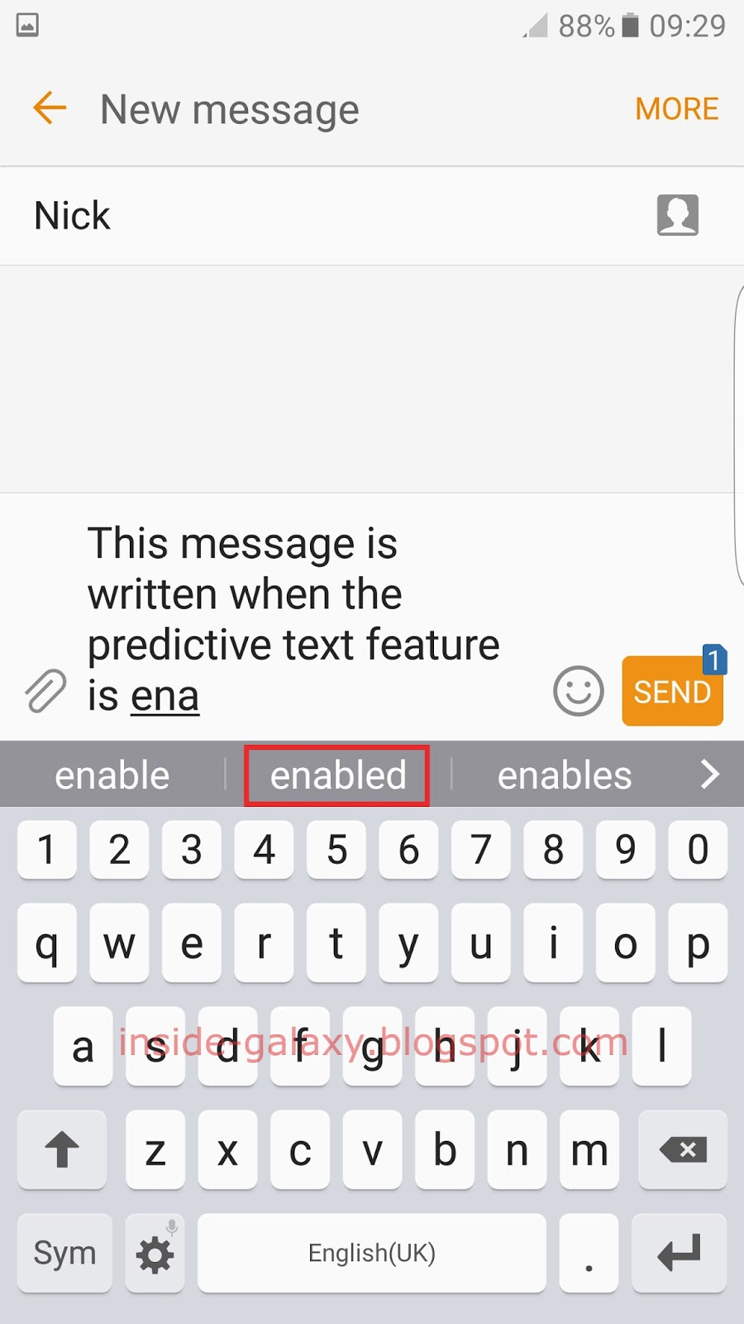
source: http://inside-galaxy.blogspot.com

Slide 13
Step 1: transitions table
Build words transition table using corpora
 | World | there | morning | bye
Hello | 80% | 20% | - | -
Good | 5% | - | 45% | 50%
this | 8% | - | 72% | -
morning | - | 100% | - | -

Slide 14
Step 2: make suggestions
Suggest next word based on last word type
World there
Hello |

Slide 15
Step 3: continuous feedback loop
This morning there was no milk!
 | World | there | morning | bye | was | no | milk
Hello | 80% | 20% | - | -
Good | 5% | - | 45% | 50%
This | 8% | - | 72% | -
morning | - | 100% | - | -
there |  |  |  |  | 100%
was |  |  |  |  |  | 100%
no |  |  |  |  |  |  | 100%

Slide 16
Code sample

Slide 17
Words generator Pseudo-country names

Slide 18
Corpora
List of country names
https://en.wikipedia.org/wiki/List_of_countries_and_dependencies_by_population

Slide 19
Using Markov chains generator
Andaleru
Cornurtos
Chriadec Korinia
Uneslgonit
Wen Rewana, dstanguthelya
Zenesco
too random?

Slide 20
n-gram
a string of elements (such as letters, words, or phonemes) that appears within a longer sequence.
“China” -> [ “Ch”; “hi”; “in”; “na” ]
[ “Chi”; “hin”; “ina” ]

Slide 21
Step 1: transitions table with n-grams order 2
n-gram order = 2
val it : Map<System.String,char []> =
map
[("Ab", [|'k'|]);
("Af", [|'r'; 'g'; 'r'|]);
("Al", [|'g'; 'b'|]);
("Am", [|'e'|]);
...]

Slide 22
Step 2: choose starting n-gram
let beginning =
transitions
|> Map.toArray
|> Array.map(fun (from, _) -> from)
|> Array.filter(startsAndEndsWithLetter)
|> chooseRandom
Af

Slide 23
Step 3: nextChar function
let nextChar (c : string) =
let items = transitions.TryFind c
items
|> Option.map(chooseRandom >> string)
|> Option.defaultValue " “
Af -> Afr

Slide 24
Step 4: generate function
let rec generate (state : string) =
if (state.Length > 200) then state
else
let lastNGram =
state.Substring(state.Length - ngramOrder, ngramOrder)
match (nextChar lastNGram) with
| "|" -> state
| c -> generate (state + c)
Af -> Afr -> Afri -> Afric -> Africa

Slide 25
Using n-grams and Markov chains generator
order = 3
Tuvalu
Seychellestein
Chad
Brundi
order = 4
Verde
Lithuania
Gambique
Mongo

Slide 26
Thanks!
ANY QUESTIONS?
https://github.com/mariuszwojcik

